Slide 1

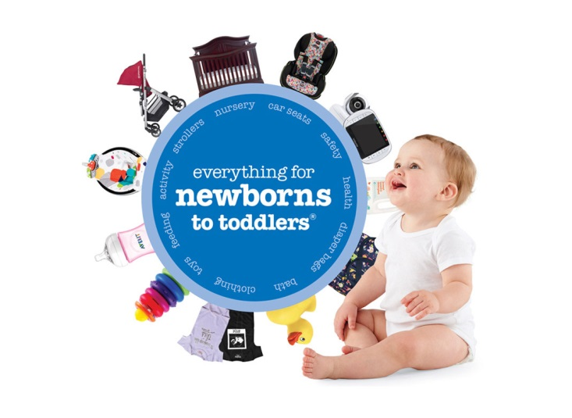
BuyBuyBaby Market Geo Analysis
Analytics
Draft
August 2, 2018

Slide 2


Name: Shruti Tripathi Education: Stevens Institute of Technology Major: Business Intelligence & Analytics (Data Science) Role at Bed Bath: Statistical Analyst Intern Team: Quantitative Analytics & Data Science Manager: Marina White Prior Experience: Software Engineer at TESCO HSC (2015-2017)
About Me

Slide 3
Table of Contents
Objective and Background
Methodology
Visualization Tools
Identification of 10 most promising Zip Codes
Summary

Slide 4
Objectives and Background
Objective
Objective is to identify zip codes where BBBaby customers do not have a store near by
Background
Every year there are approximately 4 million babies born in the US
Families that expect babies or have kids that are of the age range 0-2 years old are potential BBBaby customers
Currently we have data on about 9 million households with expecting parents or new parents across US
Out of these households, approximately 1 million do not have a BBBaby store in a 40 miles radius (~ 1/9th of our population)
Our target is to identify areas which have a high concentration of these customer addresses but do not have a store in a 40 mile radius

Slide 5
Methodology
Analysis attempts to identify top 10 zip codes for prospect stores
Analyze distribution of address across zip codes and identify areas of concentration of our target population
Filter population by income range and distance to store
Rank areas according concentration of customer households
Use ranking to pick top 10 zip codes for prospect stores
Data used for the analysis
Baby Due Date data was used from July 2016 till July 2018
Distance to store calculated using haversine formula based on latitude and longitude of addresses
Acxiom Demographic Resident Data attributes:
Presence of Child 0-2
New Parent
Estimated Household Income

Slide 6
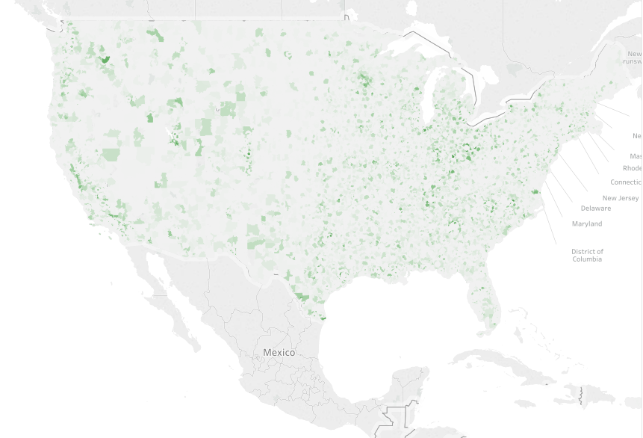
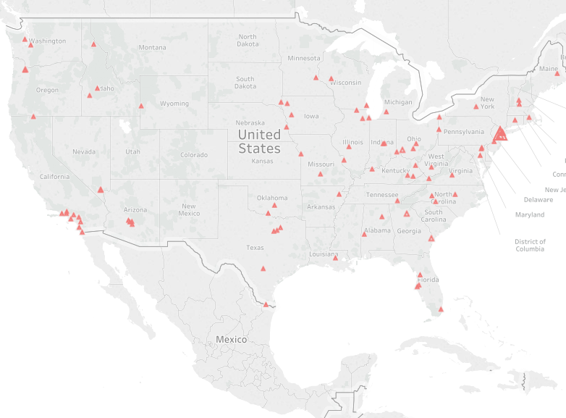
Distribution of customer addresses and stores
New Families by Zip Code
Store Locations
The first maps plots the concentration of addresses with baby customers according to zip codes and the second map plots the distribution of stores

Slide 7
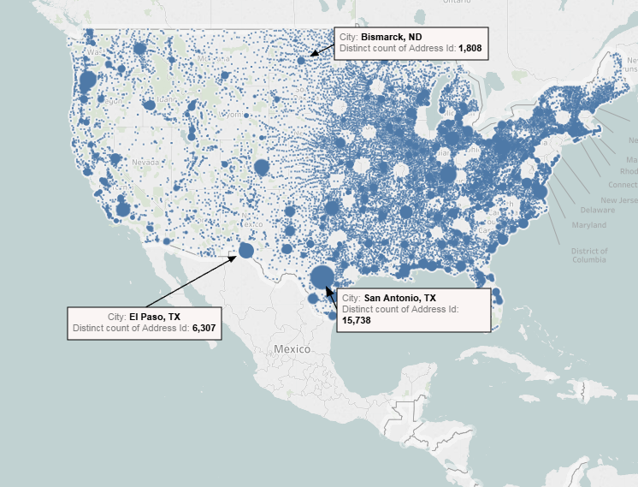
Distribution of customer addresses by income and distance to store
This map plots the concentration of addresses with baby customers according to zip codes, distance to store and income bracket

Slide 8
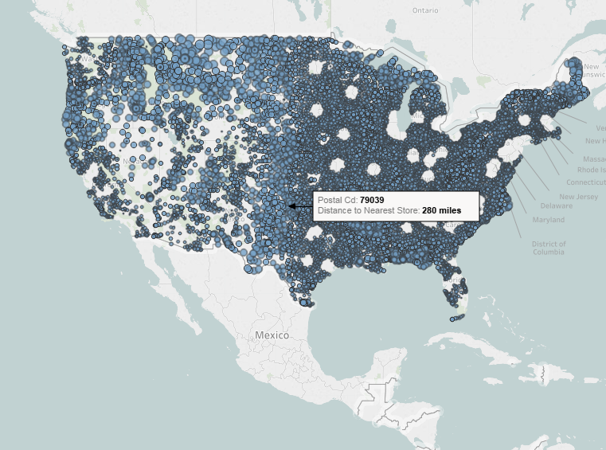
Distribution of customer addresses according to distance to stores
This map plots the concentration of addresses by the distance to their nearest store

Slide 9
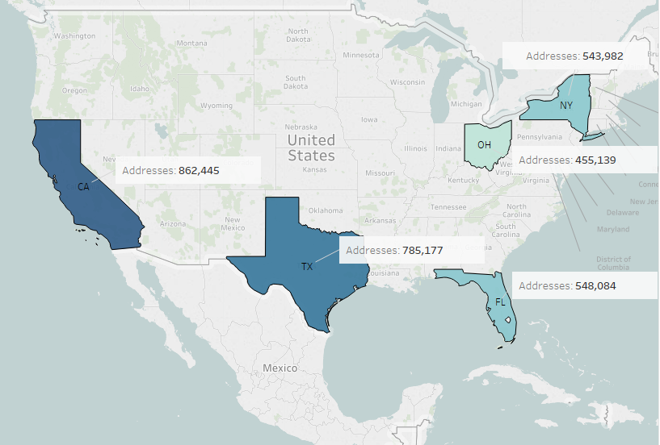
Breakdown of address by states
Top 5 populated states according to customer addresses

Slide 10
Choosing income range to target

Slide 11
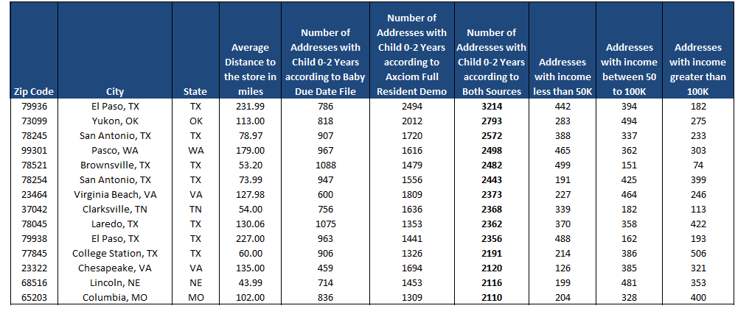
Identifying Zip codes For New Store - Data
Sample data of zip code level information
There are 41,685 zip codes in total in the US
We do not have a store in 21,694 of them
The table above has information about distance to nearest store, number of addresses and their break down by income bracket for eat zip code

Slide 12
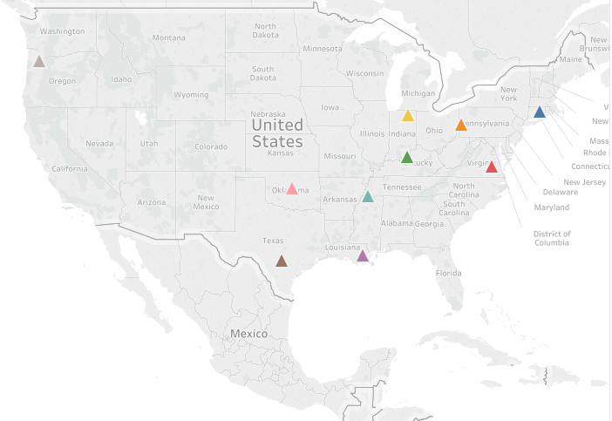
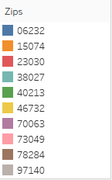
Identifying Zip codes For New Store - Methodology
Filter out target customers
For each zip code, retrieve out the addresses that do not have a store in a 40 mile radius
This accounted for 10% of our total population (~ 1Million households)
Identify addresses with parents that also have income above 50k
52 % of our 1Million households fall above this income range (~ 0.6Million)
Filter top 10 zip codes
Created rankings for each zip according to addresses concentration and picked the top 10 populated zip codes

Slide 13
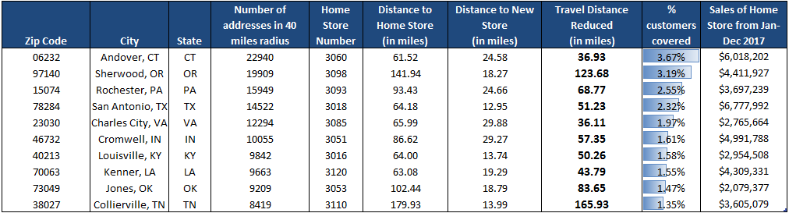
Identifying top 10 Zip codes - Summary
These zip codes represent places with highest concentration of baby customer address and distance to the nearest store
They constitute of 22% of our customers population with no store in a 40 mile radius and an income of above 50k

Slide 14
Future Methodology
Develop estimation techniques to optimize zip code identification
Use variable importance techniques to identify other influential factors that increase Baby sales
Include these factors in filtering out population
Using this population further optimize zip code identification
Identify zip codes with Bed Bath stores which do not have a BBBaby store nearby
Explore prospect of incorporating a BBBaby store with in a BBB store

Slide 15

What I Learnt
Exposure to working with large customer datasets
Visualization and Presentation skills
Taking ownership of individual project
Collaboration and team work

Slide 16
Thankyou!

